Slide 1
The Role of Prophetic Religion in the Success of the Civil Rights Movement
Northern Liberalism (Philosophy/Human Reason)
Vs
Southern Faith Movement (Christian Protestant Old Testament Bible Stories)

Slide 2
Rev. Martin Luther King Jr. &
The American Civil Rights Movement 1954 - 1968

Slide 3
Reverend King Preaching a Sermon

Slide 4
What Makes A Country Great??

Slide 5
U.S. Declaration of Independence
1776

Slide 6
How are we all equal???

Slide 7
Civil Rights Movement
To End Discrimination & Segregation
Segregation in public schools and other areas
Voting Rights
Fair Housing
Equal Job Opportunities
Equal Pay

Slide 9
Civil Rights Movement 1954-1968
Civil Resistance
Civil Protests
Civil Disobedience

Slide 10
1960’s Race Riots in Several Major U.S. cities
Detroit, Michigan 1967

Slide 16
Non- Violent Protests
Montgomery, AL bus boycott, 1955
The Albany, GA movement, 1961
Birmingham, AL campaign, 1963
March on Washington, 1963
Bloody Sunday, 1965
Chicago, 1966
Vietnam War opposition, 1967
Poor People’s campaign, 1968

Slide 17
Bible Old Testament References in Kings speeches
Jeremiah 23:25-28
Amos 5:24
Micah 4:4
Isaiah 11:6, 40:4

Slide 19
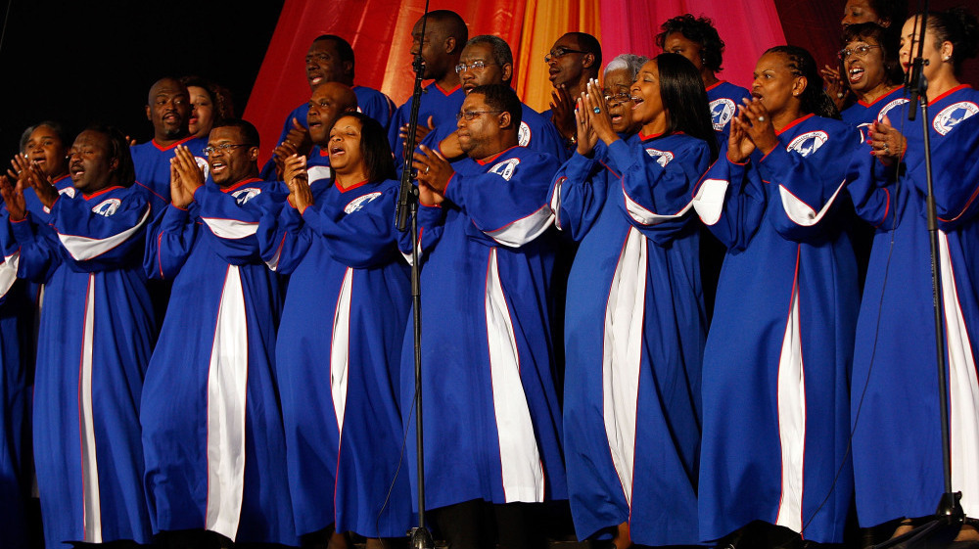
Music
“One More Day”
By Mississippi Choir

Slide 20
Reverend King Preaching a Church Sermon

Slide 21
The Civil Rights Movement as a Religious Revival
Sunday Church Worship
Church Weekly Revivals
Church Camp Meetings
Church Domination General Assemblies
Southern Christian Leadership Conferences

Slide 22
Successes of the Movement
Civil Rights Act of 1964
Voting Rights Act of 1965
Immigration and Nationality Services Act of 1965
The Fair Housing Act of 1968

Slide 23
Assassinated on April 4, 1968 on Memphis, Tennessee hotel balcony

Slide 25
Rev. Kings Funeral

Slide 26
March on Washington
“I Have a Dream” Speech
1963

